Slide 1
UNIT-1
Data Modeling

Slide 2
Data modeling
A data model is a collection of conceptual tools for describing data, data relationships, data semantics, and consistency constraints.
A data model is a conceptual framework that defines how data is structured, stored, and manipulated in a database system. It provides a systematic way to represent real-world entities and their relationships while ensuring data integrity and consistency.
In simple terms, Data models define how the logical structure of a database is modeled. Data Models are fundamental entities to introduce abstraction in a DBMS.
Categories of Data Models
High-level or conceptual data models provide concepts that are close to the way many users perceive data, whereas low-level or physical data models provide concepts that describe the details of how data is stored in the computer.
Notes:
Data Model is the modeling of the data description, data semantics, and consistency constraints of the data
Concepts provided by low-level data models are generally meant for computer specialists, not for typical end users
In Database Management Systems (DBMS), data semantics refers to the meaning and interpretation of data stored in the database, ensuring consistency, integrity, and relevance. It helps in defining how data should be understood, processed, and related to other data within the database.
Data Models in DBMS include the following:
Hierarchical Model. This concept uses a hierarchical tree structure to organize the data. ...
Network Model. ...
Entity-Relationship Model. ...
Relational Model. ...
Object-Oriented Data Model. ...
Object-Relational Data Model. ...
Flat Data Model. ...
Semi-Structured Data Model.

Slide 3
Types of Data Models
1. Hierarchical Data Model 2. Network Data Model 3. Relational Data Model 4. Object-Oriented Data Model

Slide 4
1. Hierarchical Data Model
In this model, data is organized in a tree-like structure, with parent-child relationships where each parent can have multiple children, but each child has only one parent.
Example: Company (Root) ├── HR (Department) │ ├── Employee1 │ ├── Employee2 ├── IT (Department) ├── Employee3 ├── Employee4

Slide 5
2. Network Data Model
The network model is an extension of the hierarchical model, allowing a more flexible structure where multiple parent-child relationships (many-to-many) exist.
Example: Student1 ──> CourseA Student1 ──> CourseB Student2 ──> CourseA Student3 ──> CourseC

Slide 6
3. Relational Data Model
In this model, data is stored in tables (relations) with rows (tuples) and columns (attributes). Relationships between tables are maintained using keys.
Example Tables: Students Table: | Student_ID | Name | Age | |----------- -|--- - |-----| | 101 | Alice | 20 | | 102 | Bob | 22 | Courses Table: | Course_ID | Course_Name | Student_ID | |---------- -|----------- --|---------- --| | CSE101 | Data Science | 101 | | MTH201 | Calculus | 102 |

Slide 7
4. Object-Oriented Data Model
This model combines the features of object-oriented programming (OOP) and databases, treating data as objects.
Example: Class: Product Attributes: Product_ID, Name, Price Methods: calculateDiscount()

Slide 8
Comparison of Data Models
Feature | Hierarchical | Network | Relational | Object-Oriented
Structure | Tree | Graph | Tables | Objects
Relationship Type | 1:N | M:N | M:N | Complex Objects
Query Flexibility | Low | Moderate | High | High
Example Use Case | File Systems | Banking | Business | CAD, Multimedia

Slide 9
Entity-Relationship Model
Entity-Relationship (ER) Model is based on the notion of real-world entities and relationships among them. While formulating real-world scenario into the database model, the ER Model creates entity set, relationship set, general attributes and constraints.
ER Model is best used for the conceptual design of a database.
ER Model is based on −
Entities and their attributes.
Relationships among entities
In ER modeling, the database structure is portrayed as a diagram called an Entity-relationship diagram
Notes:
ER model stands for an Entity-Relationship model. It is a high-level data model.
This model is used to define the data elements and relationship for a specified system.
It develops a conceptual design for the database
. It also develops a very simple and easy to design view of data.
In ER modeling, the database structure is portrayed as a diagram called an entity-relationship diagram.
Constructing ER diagrams is the first step in designing a database after requirements gathering which helps designer to understand and specify desired components of database system and the relationships among those components.

Slide 10
Why use ER Diagrams?
Helps you to define terms related to entity relationship modeling
Provide a preview of how all your tables should connect, what fields are going to be on each table
Helps to describe entities, attributes, relationships
ER diagrams are translatable into relational tables which allows you to build databases quickly
ER diagrams can be used by database designers as a blueprint for implementing data in specific software applications
The database designer gains a better understanding of the information to be contained in the database with the help of ERP diagram
ERD Diagram allows you to communicate with the logical structure of the database to users

Slide 11
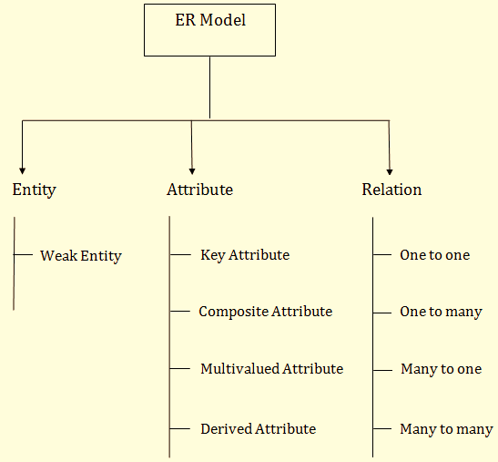

Slide 12
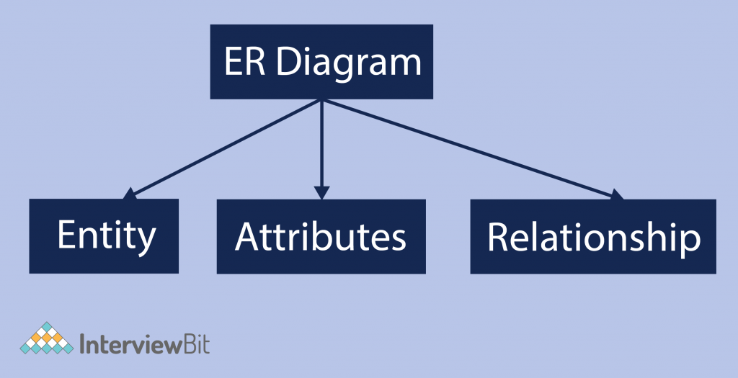
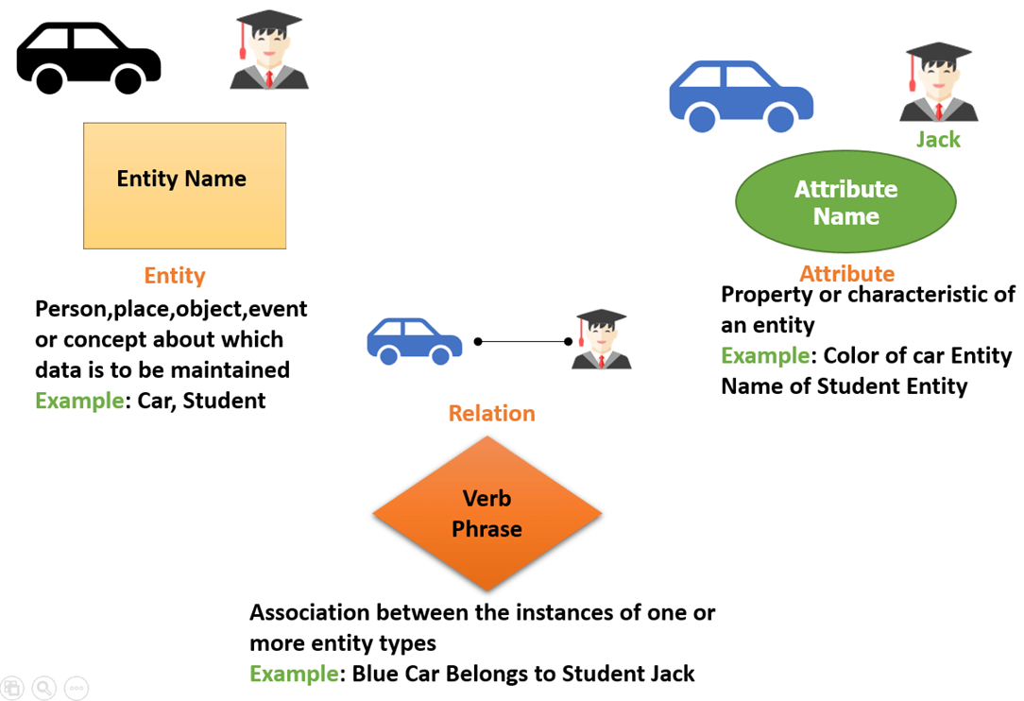
Entity Relationship (ER) Model
ER diagrams are created based on three basic concepts: entities, attributes, and relationships.

Slide 13
Entity
An entity in an ER Model is a real-world object.
An entity is a “thing” or “object” in the real world that is distinguishable from all other objects.
For example, each person in an enterprise is an entity.
Each entity has attributes—the particular properties that describe it. Or Attributes are descriptive properties possessed by each member of an entity set.
For example, an employee entity may be described by the employee’s name, age, address, salary, and job.
Notes:
Entity Sets
An entity is a “thing” or “object” in the real world that is distinguishable from all
other objects. For example, each person in an enterprise is an entity. An entity has a
set of properties, and the values for some set of properties may uniquely identify an
entity. For instance, a person may have a person-id property whose value uniquely
identifies that person. Thus, the value 677-89-9011 for person-id would uniquely identify
one particular person in the enterprise

Slide 14
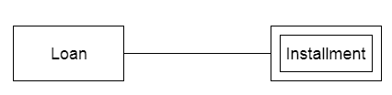
Weak Entity
An entity that depends on another entity called a weak entity. The weak entity doesn't contain any key attribute of its own. The weak entity is represented by a double rectangle.

Slide 15
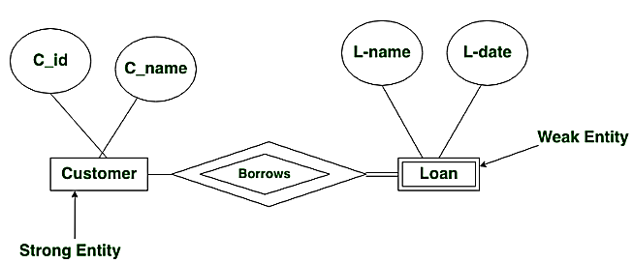

Slide 16
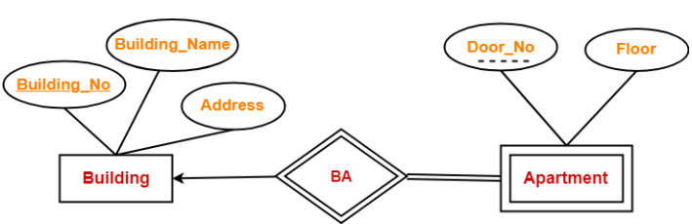
Weak entity example
Notes:
Identifying relationships(double line between BA and apartment) exist when the primary key of the parent entity is included in the primary key of the child entity.
Employee has dependent.
Customer borrows loan.

Slide 17
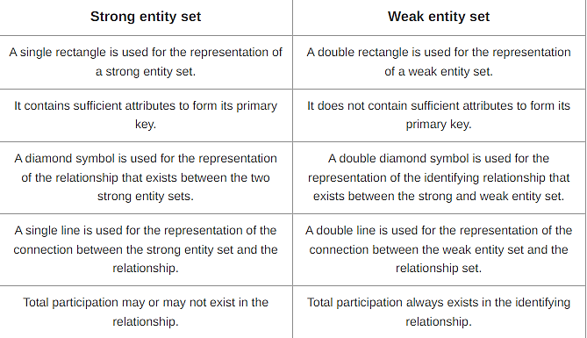

Slide 18
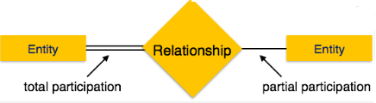
Total and Partial Participation
Total Participation − Each entity is involved in the relationship. Total participation is represented by double lines.
Partial participation − Not all entities are involved in the relationship. Partial participation is represented by single lines.

Slide 19
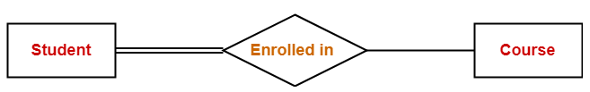
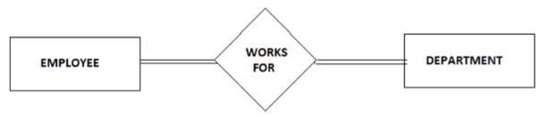
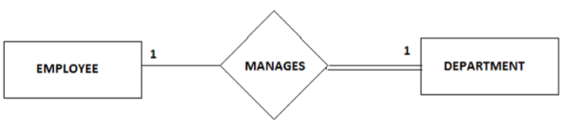
Examples
Notes:
For example: Consider two entities Employee and Department and they are related to each other via Manages relationship. An Employee must manage a Department, he or she could be the head of the department. But not every Employee in the company manages the department. So, participation of employee in the Manages relationship type is partial i.e. only a particular set of Employees will manage the Department but not all.

Slide 20
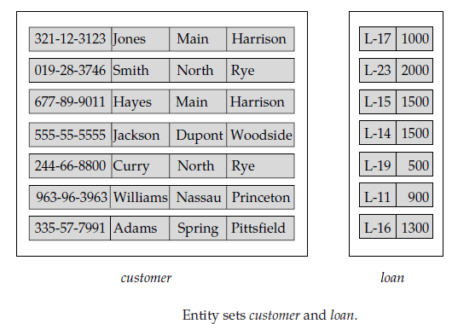
Entity set
An entity set is a set of entities of the same type that share the same properties, or attributes. The set of all persons who are customers at a given bank, for example, can be defined as the entity set customer.
The individual entities that constitute a set are said to be the extension of the entity set. Thus, all the individual bank customers are the extension of the entity set customer.
Notes:
An entity set in DBMS is a set that collectively represents a group of entities of a similar type.

Slide 21
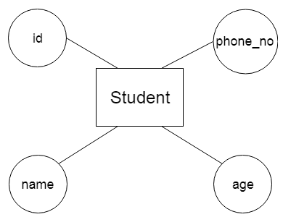
Attribute
The attribute is used to describe the property of an entity.
For example, id, age, contact number, name, etc. can be attributes of a student.

Slide 22
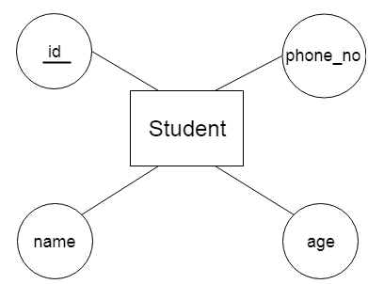
Key Attribute
The key attribute is used to represent the main characteristics of an entity. It represents a primary key. The key attribute is represented by an ellipse with the text underlined.

Slide 23
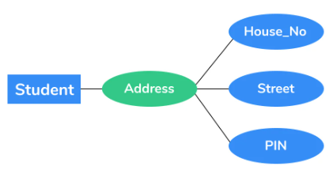
Simple attribute
Simple attributes can’t be divided any further. For example, a student’s dept_name. It is also called an atomic value.
Composite attribute
It is possible to break down composite attribute. For example, a student’s full name may be further divided into first name, second name, and last name.

Slide 24
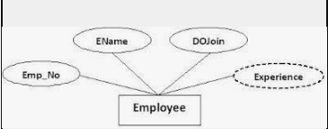
Derived attribute
This type of attribute does not include in the physical database. However, their values are derived from other attributes present in the database. For example, age should not be stored directly. Instead, it should be derived from the DOB of that employee.

Slide 25
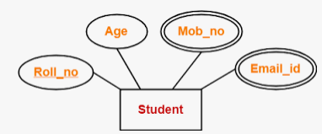
Multivalued attribute
Multivalued attributes can have more than one values. For example, a student can have more than one mobile number, email address, etc.

Slide 26
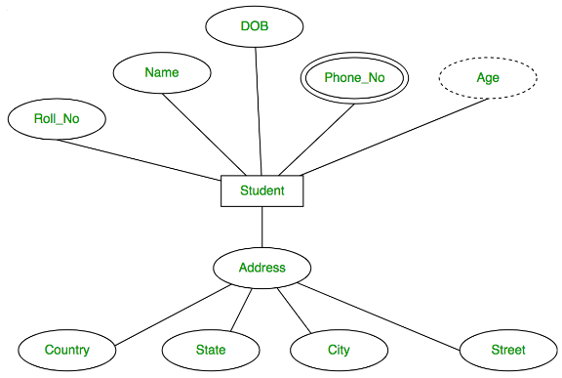
Notes:
Name can be further has two parts like first name and last name so can be considered as a composite attributes.
Example: Draw Entity and associated attributes for patient/Employee.

Slide 27
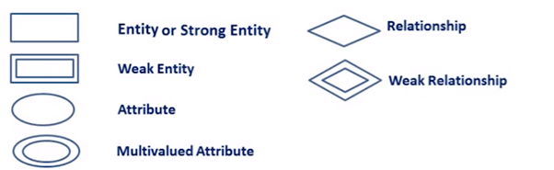

ER Diagram Symbols
Rectangles: This Entity Relationship Diagram symbol represents entity types
Double Rectangles: Weak Entity Sets
Ellipses : Symbol represent attributes
Double Ellipses: Represent multi-valued attributes
Dashed Ellipses: Derived Attributes
Diamonds: This symbol represents relationship types
Lines: It links attributes to entity types and entity types with other relationship types
Primary key: attributes are underlined

Slide 28
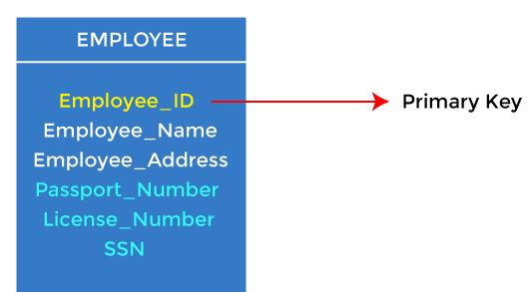
Types of keys
KEYS in DBMS
It is an attribute or set of attributes which helps you to identify a row(tuple) in a relation(table). They allow you to find the relation between two tables.
1. Primary key
It is the first key used to identify one and only one instance of an entity uniquely.
Notes:
SQL PRIMARY KEY Constraint
The PRIMARY KEY constraint uniquely identifies each record in a table.
Primary Key is a minimal set of attribute (or set of attributes) that is used to uniquely identifies all attributes in a relation.
Primary keys must contain UNIQUE values, and cannot contain NULL values.
A table can have only ONE primary key; and in the table, this primary key can consist of single or multiple columns (fields).
CREATE TABLE Persons (
ID int NOT NULL,
LastName varchar(255) NOT NULL,
FirstName varchar(255),
Age int,
CONSTRAINT PK_Person PRIMARY KEY (ID,LastName)
);
SQL PRIMARY KEY on ALTER TABLE
ALTER TABLE Persons
ADD CONSTRAINT PK_Person PRIMARY KEY (ID,LastName);
DROP a PRIMARY KEY Constraint
ALTER TABLE Persons
DROP PRIMARY KEY;

Slide 29
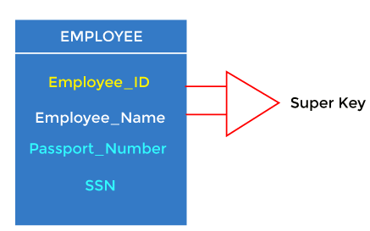
2. Super key
Super key is an attribute set that can uniquely identify a tuple. A super key is a superset of a candidate key.
There can be more than one super key in a table.
Notes:
Example, STUD_NO, (STUD_NO, STUD_NAME, CLASS), etc
. Or A super key is a group of single or multiple keys that identifies rows in a table. It supports NULL values. Example: SNO+PHONE is a super key.

Slide 30
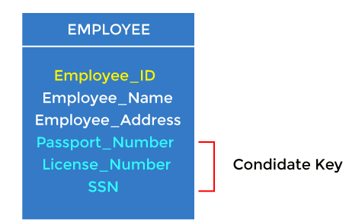
3. Candidate key
It is a set of attributes that uniquely identify tuples in a table. OR
The minimal set of attributes that can uniquely identify a tuple is known as a candidate key. For Example, STUD_NO in STUDENT relation.

Slide 31
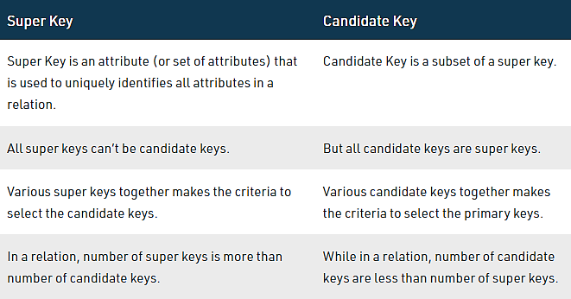
Candidate key Vs Super key

Slide 32
4. Foreign key
Foreign keys are the column of the table used to point to the primary key of another table. A foreign key is a key used to link two tables together.
Every employee works in a specific department in a company, and employee and department are two different entities. So we can't store the department's information in the employee table. That's why we link these two tables through the primary key of one table.
We add the primary key of the DEPARTMENT table, Department_Id, as a new attribute in the EMPLOYEE table.
In the EMPLOYEE table, Department_Id is the foreign key, and both the tables are related.
Notes:
It is also called as referencing key.
A FOREIGN KEY is a field (or collection of fields) in one table, that refers to the PRIMARY KEY in another table.
The table with the foreign key is called the child table, and the table with the primary key is called the referenced or parent table.
Foreign key is used to maintain referential integrity(It ensures that relationship between two related tables will remain consistent)
SQL FOREIGN KEY on CREATE TABLE
SQL FOREIGN KEY on ALTER TABLE
ALTER TABLE Orders ADD FOREIGN KEY (PersonID) REFERENCES Persons(PersonID);
DROP a FOREIGN KEY Constraint
ALTER TABLE Orders DROP FOREIGN KEY FK_PersonOrder;

Slide 33
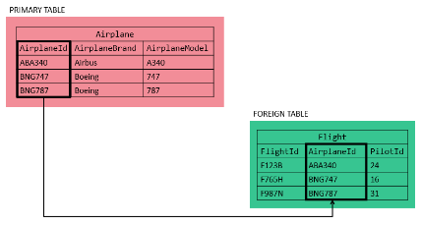
Foreign key cntd..
Notes:
Referential integrity refers to the relationship between tables.
A referential integrity rule is a rule defined on a key (a column or set of columns) in one table that guarantees that the values in that key match the values in a key in a related table (the referenced value).

Slide 34
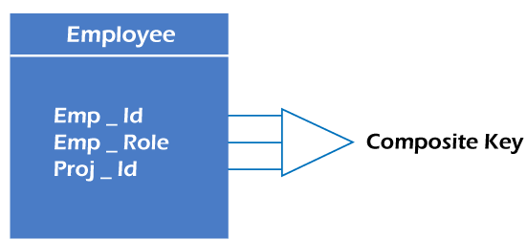
Composite key
Whenever a primary key consists of more than one attribute, it is known as a composite key. This key is also known as Concatenated Key.
Notes:
For example, each of the VehicleID and Registration attributes of the entity type CAR is a key in its own right. The Registration attribute is an example of a composite key formed from two simple component attributes, RegistrationNumber and State, neither of which is a key on its own. An entity type may also have no key, in which case it is called a weak entity type

Slide 35
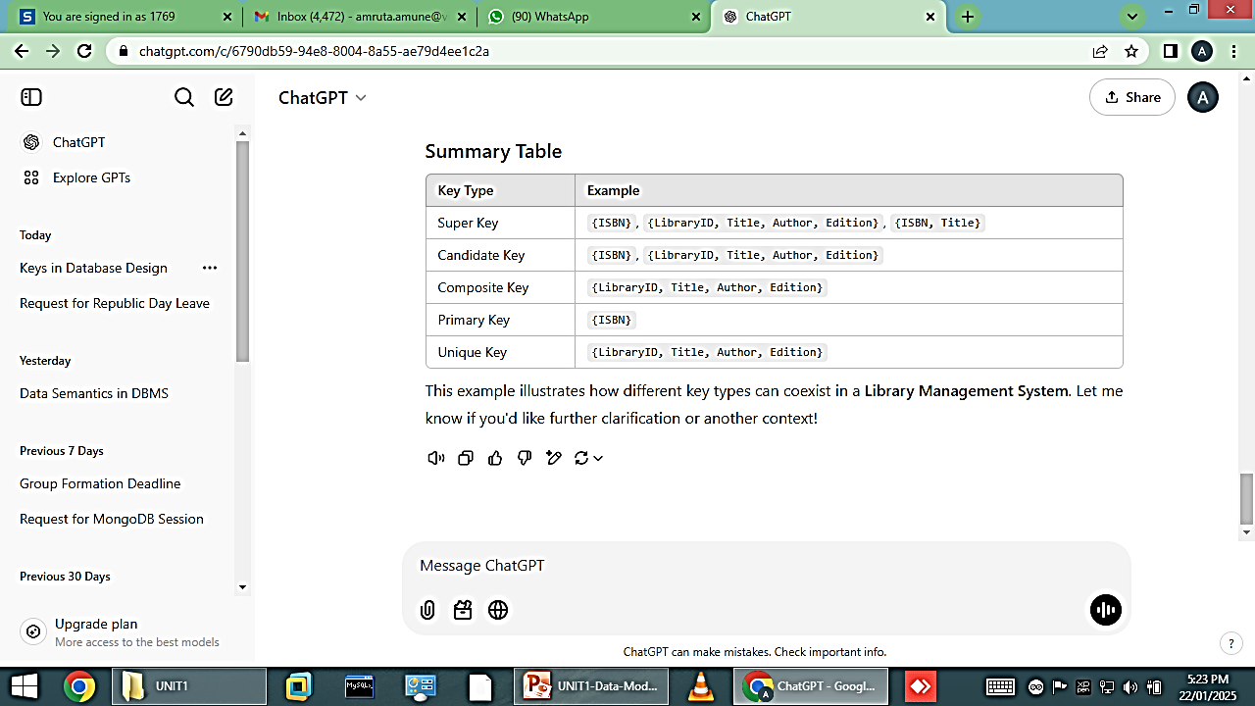

Slide 36
Relational Integrity
These integrity constraint provide a way of ensuring that changes made to the database by authorized users do not results in a loss of data consistency and correctness.
Example:
Bank customer age should not less than 18.
No two customers can have same customer id.
Student can not take admission in branch that is not available in the college.

Slide 37
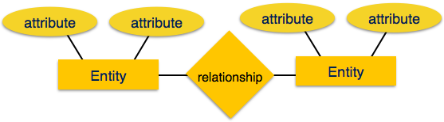
Relationship
The logical association among entities is called relationship. Relationships are mapped with entities in various ways. Mapping cardinalities define the number of association between two entities.

Slide 38
Relationship- Mapping cardinalities
One to one
An entity in A is associated with at most one entity in B, and an entity in B is associated with at most one entity in A.
One to many. An entity in A is associated with any number (zero or more) of entities in B. An entity in B, however, can be associated with at most one entity in A.
Many to one An entity in A is associated with at most one entity in B. An entity in B, however, can be associated with any number (zero or more) of entities in A.
Many to many. An entity in A is associated with any number (zero or more) of entities in B, and an entity in B is associated with any number (zero or more) of entities in A.

Slide 39
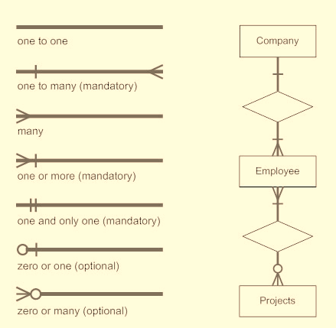

Slide 40
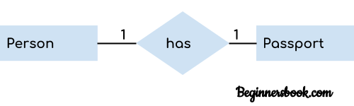
Component of ER Diagram
A relationship is used to describe the relation between entities.
A relationship is represented by diamond shape in ER diagram.
There are four types of relationships/Cardinality
One to One
One to Many
Many to One
Many to Many
1. One to One Relationship
When a single instance of an entity is associated with a single instance of another entity then it is called one to one relationship.
For example, a person has only one passport and a passport is given to one person.

Slide 41
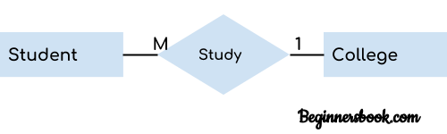

Attribute
2. One to Many Relationship
When only one instance of the entity on the left, and more than one instance of an entity on the right associates with the relationship then this is known as a one-to-many relationship.
For example, Scientist can invent many inventions, but the invention is done by the only specific scientist.
3. Many-to-one relationship
When more than one instance of the entity on the left, and only one instance of an entity on the right associates with the relationship then it is known as a many-to-one relationship.
For example – many students can study in a single college but a student cannot study in many colleges at the same time.

Slide 42

Component of ER Diagram
4. Many to Many Relationship
When more than one instances of an entity is associated with more than one instances of another entity then it is called many to many relationship.
For example, Employee can assign by many projects and project can have many employees.

Slide 43
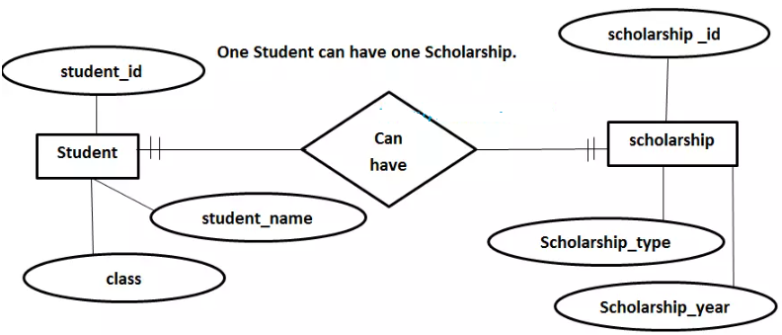
One-and-only-one Example

Slide 44
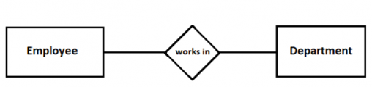
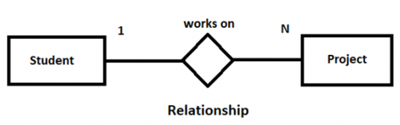
examples

Slide 45
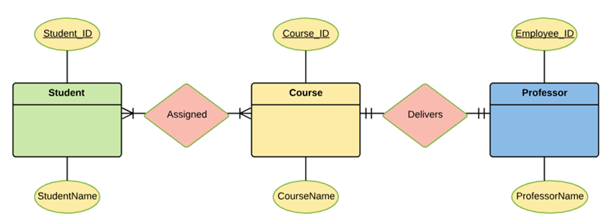
ER Diagram example

Slide 46
Role Names & Recursive Relationships
In some cases the same entity type participates more than once in a relationship type in different roles. In such cases the role name becomes essential for distinguishing the meaning of the role that each participating entity plays. Such relationship types are called recursive relationships. Ex: The SUPERVISION relationship type relates an employee to a supervisor, where both employee and supervisor entities are members of the same EMPLOYEE entity set. Hence, the EMPLOYEE entity type participates twice in SUPERVISION : once in the role of supervisor (or boss), and once in the role of supervisee (or subordinate).
Notes:
Role: A role name explains how an object participates in the relationship.

Slide 47
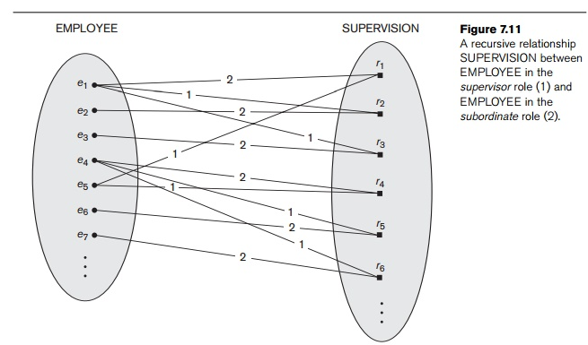
Notes:
Each relationship instance r_{i} in SUPERVISION associates two employee entities e_{j} and e_{k}, one of which plays the role of supervisor and the other the role of supervisee. In Figure 7.11, the lines marked ‘1’ represent the super-visor role, and those marked ‘2’ represent the supervisee role; hence, e₁ supervises e₂ and e₃, e₄ supervises e₆ and e₇, and e₅ supervises e₁ and e₄. In this example, each relationship instance must be connected with two lines, one marked with ‘1’ (supervisor) and the other with ‘2’ (supervisee).

Slide 48
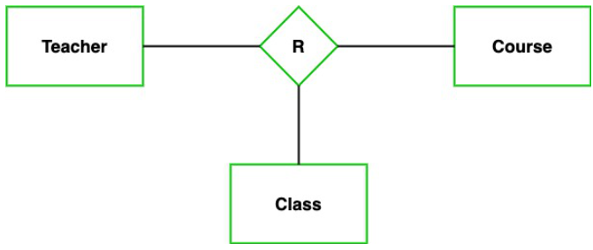
Degree of Relationships
In DBMS, a degree of relationship represents the number of entity types that associate in a relationship.
For Ex. Binary relationship type, Ternary relationship type.
Notes:
Example: We have three entity types ‘Teacher’, ‘Course’, and ‘Class’. The relationship between these entities is defined as the teacher teaching a particular course, also the teacher teaches a particular class. So, here three entity types are associating we can say it is a ternary relationship.

Slide 49

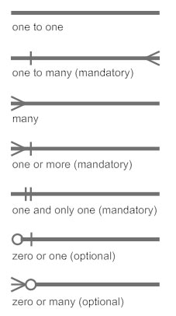
How to Create an Entity Relationship Diagram (ERD)
In a university, a Student enrolls in Courses. A student must be assigned to at least one or more Courses. Each course is taught by a single Professor. To maintain instruction quality, a Professor can deliver only one course.

Slide 50
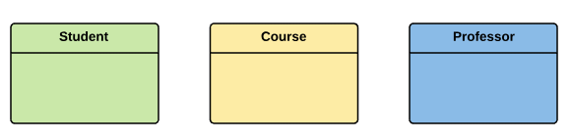
How to Create an Entity Relationship Diagram (ERD)
Step 1) Entity Identification
We have three entities
Student
Course
Professor
In a university, a Student enrolls in Courses. A student must be assigned to at least one or more Courses. Each course is taught by a single Professor. To maintain instruction quality, a Professor can deliver only one course.

Slide 51
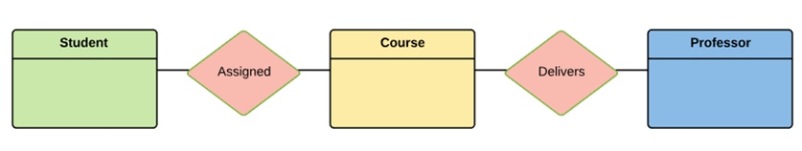
How to Create an Entity Relationship Diagram (
Step 2) Relationship Identification
We have the following two relationships
The student is assigned a course
Professor delivers a course
In a university, a Student enrolls in Courses. A student must be assigned to at least one or more Courses. Each course is taught by a single Professor. To maintain instruction quality, a Professor can deliver only one course.

Slide 52
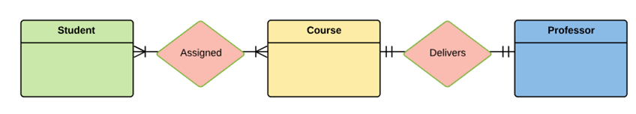
How to Create an Entity Relationship Diagram
In a university, a Student enrolls in Courses. A student must be assigned to at least one or more Courses. Each course is taught by a single Professor. To maintain instruction quality, a Professor can deliver only one course.
Step 3) Cardinality Identification
For them problem statement we know that,
A student can be assigned multiple courses
A Professor can deliver only one course

Slide 53
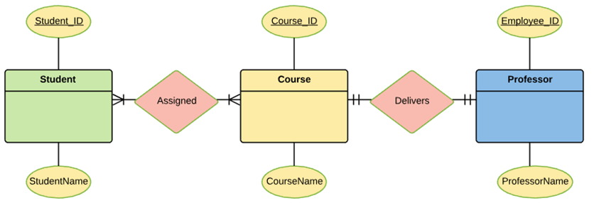
How to Create an Entity Relationship Diagram
Entity | Primary Key | Attribute
Student | Student_ID | StudentName
Professor | Employee_ID | ProfessorName
Course | Course_ID | CourseName
Step 4) Identify Attributes
You need to study the files, forms, reports, data currently maintained by the organization to identify attributes. You can also conduct interviews with various stakeholders to identify entities. Initially, it’s important to identify the attributes without mapping them to a particular entity.
Once, you have a list of Attributes, you need to map them to the identified entities. Once the mapping is done, identify the primary Keys. If a unique key is not readily available, create one.

Slide 54
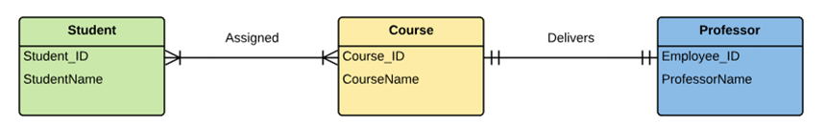
How to Create an Entity Relationship Diagram (ERD)
Entity | Primary Key | Attribute
Student | Student_ID | StudentName
Professor | Employee_ID | ProfessorName
Course | Course_ID | CourseName
Step 5) Create the ERD Diagram

Slide 55
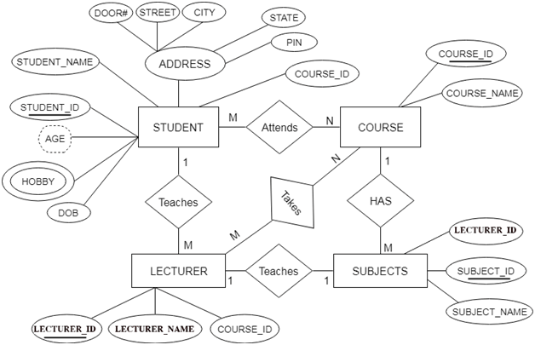
Sample ER Diagram for Student Database

Slide 56
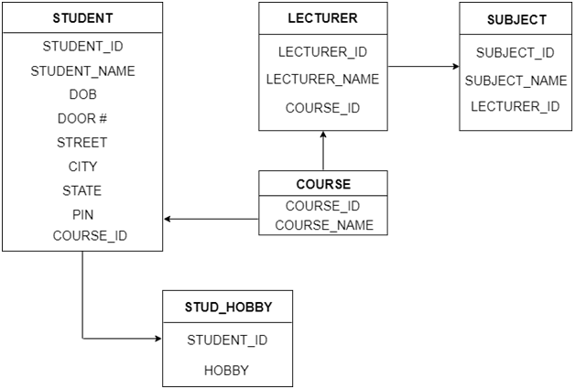
ER to Table Conversion

Slide 57
Online Food ordering system
Customers register on the platform by providing their name, phone number, email, and delivery address. Restaurants register their business, including the restaurant name, location, and contact number.
Each restaurant creates a menu consisting of dishes with names and prices.
Customer places an order by selecting dishes from a specific restaurant.
After the order is placed, a delivery agent is assigned to pick up the order from the restaurant and deliver it to the customer.

Slide 58
Advantages of ER Model
Conceptually it is very simple: ER model is very simple because if we know relationship between entities and attributes, then we can easily draw an ER diagram.
Better visual representation: ER model is a diagrammatic representation of any logical structure of database. By seeing ER diagram, we can easily understand relationship among entities and relationship.
Effective communication tool: It is an effective communication tool for database designer.
Highly integrated with relational model: ER model can be easily converted into relational model by simply converting ER model into tables.
Easy conversion to any data model: ER model can be easily converted into another data model like hierarchical data model, network data model and so on.

Slide 59
Extended ER Model
ER Diagram can be used to represent only basic features of data model.
Enhanced entity-relationship diagrams are advanced database diagrams very similar to regular ER diagrams which represent requirements and complexities of complex databases. It is a diagrammatic technique for displaying the Sub Class and Super Class; Specialization and Generalization; Union or Category; Aggregation etc.
In addition to ER model concepts EE-R includes −
Subclasses and Super classes.
Specialization and Generalization.
Category or union type.
Aggregation
Notes:
Shortcomings of ER model
1] inadequate constraints and specifications- some information can be lost in ER model as there is no way to represent some constraints.
2] No industry standards- ER models has not standardized for universal usage and symbols.
3] It is difficult to show data manipulation in ER model.

Slide 60
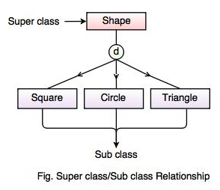
Super classes and Subclasses- Inheritance relationship
Super class and sub class relationship leads to concept of inheritance.
The relationship between sub class and super class is denoted with symbol.
d
Notes:
Square, Circle, Triangle are the sub class of Shape super class.

Slide 61
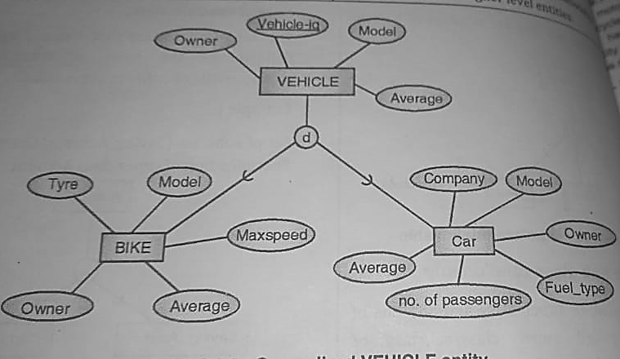

Slide 62
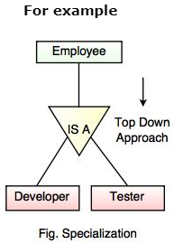
Specialization
Specialization is a process that defines a entities which is divided into sub groups based on their characteristic.
It is a top down approach, in which one higher entity can be broken down into two lower level entity.

Slide 63
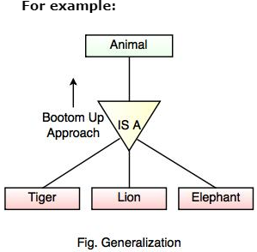
Generalization
Generalization is the process of generalizing the entities which contain the properties of all the generalized entities, i.e., subclasses are combined to make a superclass.
It is a bottom approach, in which two lower level entities combine to form a higher level entity.
Notes:
In the above example, Tiger, Lion, Elephant can all be generalized as Animals.

Slide 64
GENERALIZATION | SPECIALIZATION
Generalization works in Bottom-Up approach. | Specialization works in top-down approach.
In Generalization, size of schema gets reduced. | In Specialization, size of schema gets increased.
Generalization is normally applied to group of entities. | We can apply Specialization to a single entity.
Generalization can be defined as a process of creating groupings from various entity sets | Specialization can be defined as process of creating subgrouping within an entity set

Slide 65
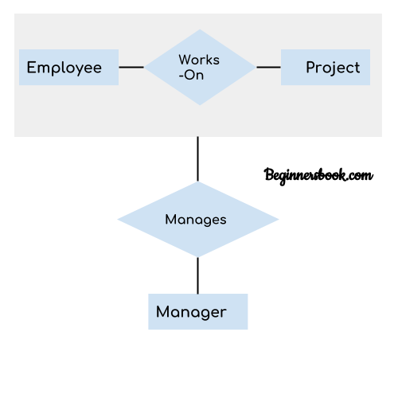
Aggregation
Aggregation is a process in which a single entity alone is not able to make sense in a relationship so the relationship of two entities acts as one entity.
Aggregation can be defined as a procedure for combining multiple entities into a single one. In database management, it is a design system performed to model relationships between a group of entities and another relationship. Its main motive is treating these relationships as a single one.
In real world, we know that a manager not only manages the employee working under them but he has to manage the project as well. In such scenario if entity “Manager” makes a “manages” relationship with either “Employee” or “Project” entity alone then it will not make any sense because he has to manage both. In these cases the relationship of two entities acts as one entity. In our example, the relationship “Works-On” between “Employee” & “Project” acts as one entity that has a relationship “Manages” with the entity “Manager”.
Notes:
In aggregation, the relation between two entities is treated as a single entity.

Slide 66
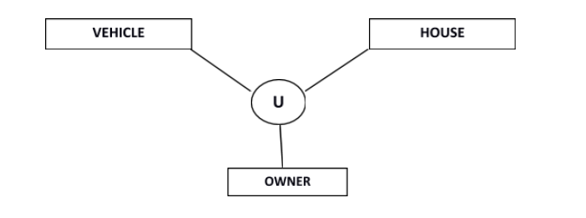
Extended ER Model
Category or Union
Relationship of one super or sub class with more than one super class.
Owner is the subset of two super class: Vehicle and House.

Slide 67
Inheritance relationship vs Union relationship
Feature | Superclass-Subclass Relationship | Union Extended Relationship
Purpose | Represents specialization/generalization. | Represents a union of two or more entities.
Nature of Relationship | "Is-a" relationship (inheritance). | "Has-a" or "union" relationship.
Entity Inheritance | Subclasses inherit attributes and relationships. | Union entity combines attributes of sources.
Usage | For entities with shared attributes and specialization. | For combining unrelated entities into one.
Example | `Person` → `Student`, `Teacher`. | `Contract` → `Employee`, `Vendor`.

Slide 68

ER Diagram practice example

Slide 69
Relational Model
Relational Model was proposed by E.F. Codd to model data in the form of relations or tables.
After designing the conceptual model of Database using ER diagram, we need to convert the conceptual model in the relational model which can be implemented using any RDBMS languages like Oracle SQL, MySQL etc.
Relational Model represents how data is stored in Relational Databases. A relational database stores data in the form of relations (tables).

Slide 70
Relational Model
ROLL_NO | NAME | ADDRESS | PHONE | AGE
1 | RAM | DELHI | 9455123451 | 18
2 | RAMESH | GURGAON | 9652431543 | 18
3 | SUJIT | ROHTAK | 9156253131 | 20
4 | SURESH | DELHI |  | 18
Consider a relation STUDENT with attributes
ROLL_NO, NAME, ADDRESS, PHONE and
AGE shown in Table.
IMPORTANT TERMINOLOGIES
Attribute: Attributes are the properties that define a relation. e.g.; ROLL_NO, NAME
Relation Schema: A relation schema represents name of the relation with its attributes. e.g.; STUDENT (ROLL_NO, NAME, ADDRESS, PHONE and AGE) is relation schema for STUDENT. If a schema has more than 1 relation, it is called Relational Schema.
Tuple: Each row in the relation is known as tuple.
The above relation contains 4 tuples, one of which is shown as:
1 | RAM | DELHI | 9455123451 | 18

Slide 71
Relational Model
ROLL_NO | NAME | ADDRESS | PHONE | AGE
1 | RAM | DELHI | 9455123451 | 18
2 | RAMESH | GURGAON | 9652431543 | 18
3 | SUJIT | ROHTAK | 9156253131 | 20
4 | SURESH | DELHI |  | 18
Relation Instance: The set of tuples of a relation at a particular instance of time is called as relation instance. Table shows the relation instance of STUDENT at a particular time. It can change whenever there is insertion, deletion or updation in the database.
Degree: The number of attributes in the relation is known as degree of the relation. The STUDENT relation defined above has degree 5.
Cardinality: The number of tuples in a relation is known as cardinality. The STUDENT relation defined above has cardinality 4.
NULL Values: The value which is not known or unavailable is called NULL value. It is represented by blank space. e.g.; PHONE of STUDENT having ROLL_NO 4 is NULL.
ROLL_NO
1
2
3
4

Slide 72


Slide 73
Relational Model
ROLL_NO | NAME | ADDRESS | PHONE | AGE
1 | RAM | DELHI | 9455123451 | 18
2 | RAMESH | GURGAON | 9652431543 | 18
3 | SUJIT | ROHTAK | 9156253131 | 20
4 | SURESH | DELHI |  | 18
Constraints in Relational Model
While designing Relational Model, we define some conditions which must hold for data present in database are called Constraints. These constraints are checked before performing any operation (insertion, deletion and updation) in database. If there is a violation in any of constrains, operation will fail.
Domain Constraints: These are attribute level constraints. An attribute can only take values which lie inside the domain range. e.g,; If a constrains AGE>0 is applied on STUDENT relation, inserting negative value of AGE will result in failure.
Key Integrity: Every relation in the database should have at least one set of attributes which defines a tuple uniquely. Those set of attributes is called key. e.g.; ROLL_NO in STUDENT is a key. No two students can have same roll number. So a key has two properties:
It should be unique for all tuples.
It can’t have NULL values.
Notes:
In a database table, we can add rules to a column known as constraints. These rules control the data that can be stored in a column. For example, if a column has NOT NULL constraint, it means the column cannot store NULL values.
Column: The column represents the set of values for a specific attribute.
Attribute domain – Every attribute has some pre-defined value and scope which is known as attribute domain
Key Integrity constraint is also called as entity integrity constraint.

Slide 74
Relational Model
Constraints in Relational Model
Referential Integrity: Referential Integrity is a concept in relational database management systems (RDBMS) that ensures the consistency and accuracy of data across related tables. Let us suppose we have 2 relations
STUDENT
BRANCH
ROLL_NO | NAME | ADDRESS | PHONE | AGE | BRANCH_CODE
1 | RAM | DELHI | 9455123451 | 18 | CS
2 | RAMESH | GURGAON | 9652431543 | 18 | CS
3 | SUJIT | ROHTAK | 9156253131 | 20 | ECE
4 | SURESH | DELHI |  | 18 | IT
BRANCH_CODE | BRANCH_NAME
CS | COMPUTER SCIENCE
IT | INFORMATION TECHNOLOGY
ECE | ELECTRONICS AND COMMUNICATION ENGINEERING
CV | CIVIL ENGINEERING
BRANCH_CODE of STUDENT can only take the values which are present in BRANCH_CODE of BRANCH which is called referential integrity constraint.
The relation which is referencing to other relation is called REFERENCING RELATION (STUDENT in this case) and the relation to which other relations refer is called REFERENCED RELATION (BRANCH in this case).

Slide 75
Relational Model
ANOMALIES
An anomaly is an irregularity, or something which deviates from the expected or normal state. When designing databases, we identify three types of anomalies: Insert, Update and Delete.
Insertion Anomaly in Referencing Relation:
We can’t insert a row in REFERENCING RELATION if referencing attribute’s value is not present in referenced attribute value. e.g.; Insertion of a student with BRANCH_CODE ‘ME’ in STUDENT relation will result in error because ‘ME’ is not present in BRANCH_CODE of BRANCH.
Deletion/ Updation Anomaly in Referenced Relation:
We can’t delete or update a row from REFERENCED RELATION if value of REFERENCED ATTRIBUTE is used in value of REFERENCING ATTRIBUTE. e.g; if we try to delete tuple from BRANCH having BRANCH_CODE ‘CS’, it will result in error because ‘CS’ is referenced by BRANCH_CODE of STUDENT, but if we try to delete the row from BRANCH with BRANCH_CODE CV, it will be deleted as the value is not been used by referencing relation. It can be handled by following method:
ON DELETE CASCADE: It will delete the tuples from REFERENCING RELATION if value used by REFERENCING ATTRIBUTE is deleted from REFERENCED RELATION. e.g;, if we delete a row from BRANCH with BRANCH_CODE ‘CS’, the rows in STUDENT relation with BRANCH_CODE CS (ROLL_NO 1 and 2 in this case) will be deleted.
ON UPDATE CASCADE: It will update the REFERENCING ATTRIBUTE in REFERENCING RELATION if attribute value used by REFERENCING ATTRIBUTE is updated in REFERENCED RELATION. e.g;, if we update a row from BRANCH with BRANCH_CODE ‘CS’ to ‘CSE’, the rows in STUDENT relation with BRANCH_CODE CS (ROLL_NO 1 and 2 in this case) will be updated with BRANCH_CODE ‘CSE’.
REFERENCING RELATION (STUDENT in this case)
REFERENCED RELATION (BRANCH in this case)

Slide 76

Codd's Rules
E.F Codd was a Computer Scientist who invented the Relational model for Database management. Based on relational model, the Relational database was created.
Dr Edgar F. Codd, after his extensive research on the Relational Model of database systems, came up with twelve rules of his own, which according to him, a database must obey in order to be regarded as a true relational database.
These rules can be applied on any database system that manages stored data using only its relational capabilities.
This is a foundation rule, which acts as a base for all the other rules.

Slide 77
Codd's Rules
Rule 0: The Foundation Rule
The database must be in relational form. So that the system can handle the database through its relational capabilities.
Rule 1: Information Rule
A database contains various information, and this information must be stored in each cell of a table in the form of rows and columns.
Rule 2: Guaranteed Access Rule
Every single or precise data (atomic value) may be accessed logically from a relational database using the combination of primary key value, table name, and column name.
Rule 3: Systematic Treatment of Null Values
This rule defines the systematic treatment of Null values in database records. The null value has various meanings in the database, like missing the data, no value in a cell, inappropriate information, unknown data and the primary key should not be null.

Slide 78
Codd's Rules
Rule 4: Active/Dynamic Online Catalog based on the relational model
It represents the entire logical structure of the descriptive database that must be stored online and is known as a database dictionary. It authorizes users to access the database and implement a similar query language to access the database.
Rule 5: Comprehensive Data Sub Language Rule
The relational database supports various languages, and if we want to access the database, the language must be the explicit, linear or well-defined syntax, character strings and supports the comprehensive: data definition, view definition, data manipulation, integrity constraints, and limit transaction management operations. If the database allows access to the data without any language, it is considered a violation of the database.
Rule 6: View Updating Rule
All views table can be theoretically updated and must be practically updated by the database systems.
Rule 7: Relational Level Operation (High-Level Insert, Update and delete) Rule
A database system should follow high-level relational operations such as insert, update, and delete in each level or a single row. It also supports union, intersection and minus operation in the database system.
Notes:
Rule 4: The structure description of the entire database must be stored in an online catalog, known as data dictionary, which can be accessed by authorized users. Users can use the same query language to access the catalog which they use to access the database itself.
An Active or Dynamic Online Catalog is a system component that provides a logical structure of a database and serves as an interface between the database management system (DBMS) and users. It is also known as the database dictionary or data dictionary.
It contains metadata about the database, which includes details about the tables, columns, constraints, relationships, and other database objects. This catalog is essential for managing and accessing the database in a relational database management system (RDBMS).
View is a virtual table in the database whose contents are taken from query or taken from one or more tables.

Slide 79
Codd's Rules
Rule 8: Physical Data Independence Rule
All stored data in a database or an application must be physically independent to access the database. Each data should not depend on other data or an application. If data is updated or the physical structure of the database is changed, it will not show any effect on external applications that are accessing the data from the database.
Rule 9: Logical Data Independence Rule
It is similar to physical data independence. It means, if any changes occurred to the logical level (table structures), it should not affect the user's view (application). For example, suppose a table either split into two tables, or two table joins to create a single table, these changes should not be impacted on the user view application.
Rule 10: Integrity Independence Rule
The database should be able to enforce its own integrity rather than using other programs. Key and Check constraints, trigger etc, should be stored in Data Dictionary. All entered values should not be changed or rely on any external factor or application to maintain integrity. This also make RDBMS independent of front-end.

Slide 80
Codd's Rules
Rule 11: Distribution Independence Rule
The distribution independence rule represents a database that must work properly, even if it is stored in different locations and used by different end-users. Suppose a user accesses the database through an application; in that case, they should not be aware that another user uses particular data, and the data they always get is only located on one site. This lays the foundation of distributed database.
Rule 12: Non Subversion Rule
The non-subversion rule defines RDBMS as a SQL language to store and manipulate the data in the database. If a system has a low-level or separate language other than SQL to access the database system, it should not subvert or bypass integrity to transform data. That is If a system has an interface that provides access to low-level records, then the interface must not be able to subvert the system and bypass security and integrity constraints.

